Slide 1


Green Pace
Security Policy Presentation
Developer: Joel “Joey” Hays
Notes:
Hello everyone. My name is Joey, and I’m excited to introduce you to the Green Pace Security Policy. Today, I’ll be presenting our comprehensive approach to secure development, which outlines key principles, coding standards, and best practices to ensure the safety and reliability of our software systems. This policy was designed not only to address current security challenges but also to lay a foundation for proactive and consistent security practices across our development teams. Let’s get started by diving into the purpose and structure of this security policy

Slide 2

OVERVIEW: DEFENSE IN DEPTH
Policy defines core security principles, coding standards, AAA, and data encryption.
Establish consistent and enforceable practices that safeguard Green Pace's systems and software from vulnerabilities.
Actively avoid security vulnerabilities
Notes:
Green Pace's Security Policy is a comprehensive document that outlines our approach to safeguarding software and systems throughout their lifecycle. The policy is built around core principles like validating input, designing for security, and enforcing least privilege. It includes specific coding standards, such as rules for memory management, handling exceptions, and secure string operations.
This policy is critical for ensuring consistency in how we approach security challenges. It helps us mitigate vulnerabilities early and align with industry best practices. One of its key purposes is to support 'Defense in Depth,' a strategy that layers multiple protections to ensure robust security. For example, these layers might include firewalls, encrypted communications, and user authentication systems.
By implementing this policy, we establish a proactive approach to identifying, mitigating, and avoiding security vulnerabilities at every stage of development. Ultimately, this ensures that Green Pace delivers secure, reliable software for our stakeholders.

Slide 3
THREATS MATRIX
Likely String Correctness Containers in Range Avoid Uncaught Exceptions | Priority SQL Injection Memory Leaks
Low priority Assertions Exception Handling | Unlikely Data Type Data Value File resources closed properly
Notes:
This Threats Matrix categorizes the potential vulnerabilities identified in our security policy based on their likelihood and priority level.
In the 'Likely' category, we have vulnerabilities such as string correctness, container range validation, and avoiding uncaught exceptions. These are common issues that often occur during development and can lead to significant errors if not addressed.
In the 'Priority' category, we address SQL injection and memory leaks. These pose a high risk to our system integrity and user data. Preventing SQL injection is critical for protecting our database, while memory leaks can significantly impact application performance and resource usage.
Moving to the 'Low Priority' category, we have assertions and exception handling. These are less critical but still important to ensure smooth execution and debugging of our programs.
Finally, the 'Unlikely' category includes data type, data value, and file resource management issues. Although these are less likely to occur, addressing them ensures our code maintains stability and avoids rare but impactful problems.
This matrix not only organizes our vulnerabilities but also provides us with a structured approach to addressing these threats based on their likelihood and potential impact

Slide 4
10 PRINCIPLES
Validate Input Data – 1, 3, 8
Heed Compiler Warnings – 6, 7
Architect and Design for Security Policies – 2, 9
Keep it Simple – 4, 5
Default Deny - 5
Adhere to the principle of Least Privilege – 2, 10
Sanitize Data sent to other systems – 4, 8
Practice Defense in Depth – 3, 9
Use Effective Quality Assurance – 6, 7, 8
Adopt a secure coding standard - ALL
Notes:
On this slide, we see the 10 guiding principles that form the foundation of the Green Pace Security Policy and how they map to the specific coding standards.
The principle Validate Input Data is applied to standards 1, 3, and 8 to ensure proper data handling and reduce vulnerabilities like buffer overflows and injection attacks.
Heed Compiler Warnings is linked to standards 6 and 7, helping us proactively identify issues early in development by resolving warnings and errors flagged by the compiler.
The principle Architect and Design for Security Policies ties to standards 2 and 9, ensuring that secure design is prioritized during system development and execution phases.
Keep it Simple applies to standards 4 and 5, emphasizing simplicity to reduce complexity, making our code more secure and maintainable.
Default Deny, a crucial security practice, is linked to standard 5, ensuring access is denied unless explicitly allowed.
The principle Adhere to the Principle of Least Privilege connects to standards 2 and 10, minimizing permissions to reduce the attack surface and limit damage from potential breaches.
Sanitize Data Sent to Other Systems is applied to standards 4 and 8, ensuring secure data exchanges and preventing vulnerabilities like injection attacks.
Practice Defense in Depth maps to standards 3 and 9, ensuring multiple layers of protection are implemented to address any potential system vulnerabilities.
The principle Use Effective Quality Assurance is critical for standards 6, 7, and 8, ensuring rigorous testing is conducted to identify and address both functional and security issues.
Finally, Adopt a Secure Coding Standard applies to all the coding standards, ensuring a consistent and secure approach to development across the organization.
By aligning our principles with coding standards, we ensure that Green Pace's development practices are rooted in robust security practices and a proactive defense strategy

Slide 5
CODING STANDARDS
10 Coding Standards:
Obey the One-Definition Rule
Avoid Modifying Standard Namespaces
Do Not Confuse Narrow and Wide Character Strings and Functions
Prevent SQL Injection
Prevent Memory Leaks
Avoid Dangerous Assertions
Handle Exceptions Appropriately
Validate Container Indices and Iterators
Avoid Uncaught Exceptions in Static and Thread Storage Duration
Ensure File Resources Are Properly Closed
Vulnerability Ranking System:
High Priority: Standards 4 (SQL Injection) and 5 (Memory Leaks).
These pose immediate risks to data security and system stability. SQL Injection can expose sensitive data, while memory leaks compromise system performance and reliability.
Medium Priority: Standards 3 (String Functions), 8 (Containers in Range), and 7 (Exception Handling).
These issues, if ignored, can lead to undefined behavior, crashes, or minor data corruption.
Low Priority: Standards 6 (Assertions), 9 (Uncaught Exceptions), and 10 (File Resources).
While important, these are less likely to be exploited directly but ensure overall code robustness.
Unlikely to Cause Immediate Threats: Standards 1 (One-Definition Rule) and 2 (Standard Namespaces).
These focus more on preventing rare and subtle bugs rather than directly exploitable vulnerabilities.
Notes:
Let’s review the 10 coding standards and how they are ranked based on potential vulnerabilities.
First, the standards:
Obey the One-Definition Rule ensures consistency across code files.
Avoid Modifying Standard Namespaces prevents undefined behavior.
Do Not Confuse Narrow and Wide Character Strings and Functions avoids data truncation and unexpected behavior.
Prevent SQL Injection ensures user inputs are sanitized to prevent malicious database access.
Prevent Memory Leaks ensures system resources are properly managed and released.
Avoid Dangerous Assertions ensures debugging information is useful without compromising stability.
Handle Exceptions Appropriately ensures exceptions are caught and handled effectively.
Validate Container Indices and Iterators ensures safe data access within bounds.
Avoid Uncaught Exceptions in Static and Thread Storage Duration prevents crashes during startup or termination.
Ensure File Resources Are Properly Closed avoids resource leakage and potential data loss.
Now, let’s discuss the ranking system:
High Priority standards, like SQL Injection and Memory Leaks, are ranked at the top because they pose immediate risks. SQL Injection can expose sensitive data, and memory leaks compromise both performance and reliability.
Medium Priority standards include String Functions, Container Range Validation, and Exception Handling. While not always catastrophic, these issues can cause crashes or undefined behavior if left unchecked.
Low Priority standards include Dangerous Assertions, Uncaught Exceptions, and File Resource Management. These are less likely to cause immediate threats but ensure robust and secure coding practices.
Finally, Unlikely Threats are standards like the One-Definition Rule and Standard Namespace modifications. These primarily focus on preventing subtle bugs and ensuring maintainability.
We ranked these standards based on their likelihood of being exploited, their severity if exploited, and their overall impact on system security and stability. This ranking system helps us prioritize where to focus our development and testing efforts

Slide 6
ENCRYPTION POLICIES
Encryption at rest - secures data stored on disk, such as in files, databases, or backups, by making it inaccessible to unauthorized users.
Encryption in flight - secures data during transmission over networks by encrypting it before sending and decrypting it upon receipt.
Encryption in use - protects data actively processed in memory from being exposed to unauthorized access.
Notes:
Our encryption policies are designed to protect data throughout its lifecycle, ensuring it remains secure no matter where it is stored or how it is used.
Starting with encryption at rest, this focuses on securing data stored on physical devices, like disks or databases, making it inaccessible to unauthorized users. This is vital for preventing unauthorized access to sensitive data, even in cases of physical theft.
Next, encryption in flight addresses securing data during transmission. By encrypting data before sending it and decrypting it upon receipt, we protect sensitive information from being intercepted or tampered with during communication.
Finally, encryption in use safeguards data that is actively being processed in memory. This is particularly important in shared or cloud environments, where unauthorized access to data during computation poses a significant risk.
These three approaches collectively ensure that data is protected at every stage—whether it's being stored, transferred, or processed—supporting our mission to maintain a strong security posture

Slide 7
TRIPLE-A POLICIES
Authentication - verifies the identity of users or systems before granting access, ensuring only legitimate entities can access resources. Strong authentication methods minimize the risk of unauthorized access.
Authorization - defines what authenticated users or systems are allowed to access or perform, ensuring compliance with organizational policies and role-based permissions.
Accounting - tracks and logs all user and system activities, providing visibility into operations and ensuring accountability. These logs support anomaly detection and forensic investigations.
Notes:
When it comes to securing systems and maintaining accountability, the Triple A framework—Authentication, Authorization, and Accounting—plays a critical role.
Authentication is the first line of defense. It ensures that only verified users or systems can access resources by validating their identities. By implementing strong authentication methods, such as multi-factor authentication, we can minimize the risk of unauthorized access and safeguard sensitive data.
Once users or systems are authenticated, authorization comes into play. This defines what actions they can perform or resources they can access, based on their role or organizational policies. This ensures that permissions are tightly controlled and that users only have access to what they need, reducing potential security risks.
Lastly, we have accounting, which involves tracking and logging all activities across systems and users. These logs provide a clear record of operations, enabling us to detect anomalies, trace incidents, and ensure accountability. Accounting is key to both proactive threat detection and forensic investigations.
By implementing these three components together, we can establish a robust framework that protects resources, ensures proper access control, and maintains transparency across our systems

Slide 8
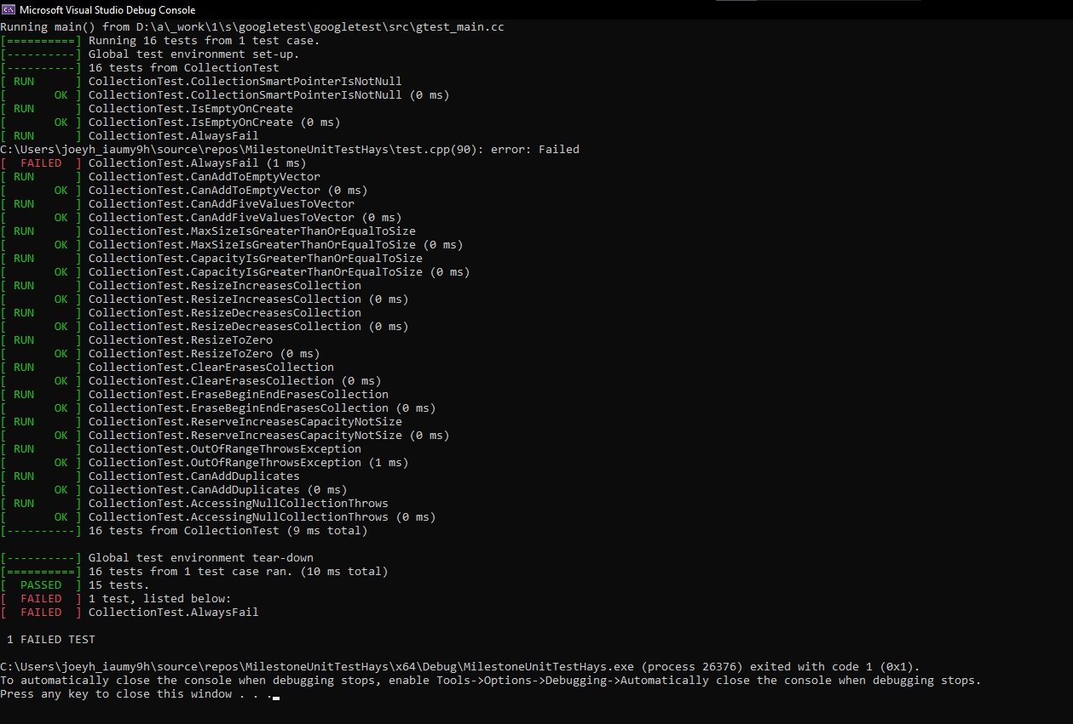
Unit Testing
Notes:
Unit testing is a fundamental practice in secure coding, providing a systematic way to catch vulnerabilities early in the development process. By testing individual components of the code in isolation, we can ensure that each function behaves as expected under various conditions, including edge cases.
The 16 unit tests shown here demonstrate how we actively verify code functionality and identify potential security issues, such as input validation, memory leaks, or out-of-bounds errors. These tests serve as an automated safety net, helping to maintain code quality and security as the project evolves.
Ultimately, unit testing not only helps to detect and mitigate vulnerabilities but also fosters a culture of accountability and precision in secure software development.

Slide 9
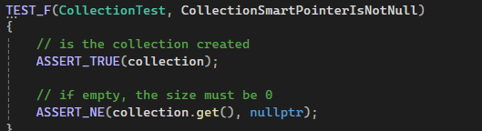
Unit Testing
This test is checking to ensure that the collection is created.
Notes:
The Unit test for Collection Smart Pointer is not null is a test that is checking to ensure the collection is created. This test is followed by another to show that the collection that was created is also empty. I will be including technical documentation of the unit tests to show and explain how they are working.

Slide 10
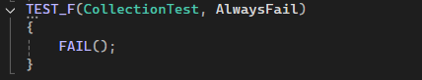
Unit Testing
This is a test that will fail by default. This is useful to show us what it will look like IF a test does fail.
Notes:
AlwaysFail is useful to show what tests will look like if they do fail. This ensures that our unit tests can fail if they are not meeting their own requirements.

Slide 11
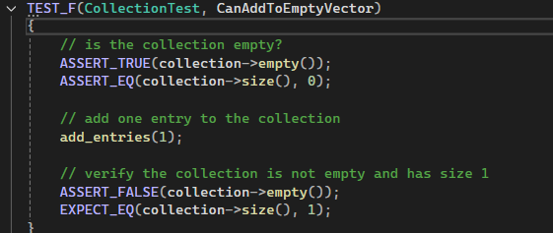
Unit Testing
This test will ensure that a single value is added to an empty collection.
Notes:
Can Add to empty Vector will ensure a single value can be added to an empty collection. This can show that our collection is able to have the size increased

Slide 12
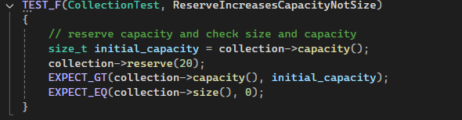
Unit Testing
This test will verify that the reserve command is increasing the capacity of the collection but not the size of the collection.
Notes:
Finally, This test is showing that we can increase the capacity of the collection but not the size of the collection. This is useful for when we know we will be adding more stuff in the future.

Slide 13

AUTOMATION SUMMARY

Slide 14
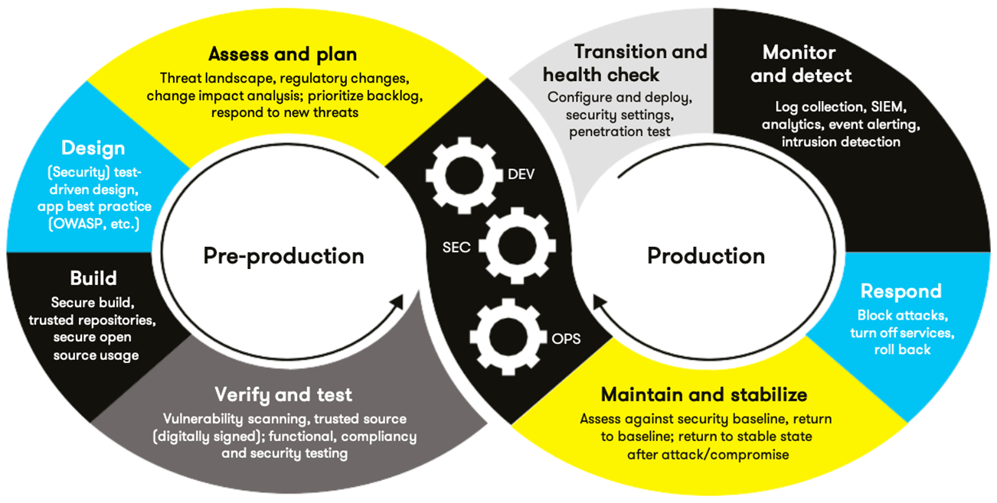
TOOLS
Security at EVERY stage
Utilize external tools for Automation.
Tools can be used to automate threat analysis, check regulatory compliance, and enforce secure coding standards during design and build steps
Notes:
Automation is critical in modern secure development practices, and at Green Pace, security is integrated at every stage of the software development lifecycle. By embedding automated tools throughout the process, we enhance our ability to identify and mitigate vulnerabilities early and efficiently.
External tools play a key role in this approach. They enable us to automate threat analysis, ensure compliance with regulatory requirements, and enforce secure coding standards—particularly during the design and build phases. This means that our systems are continuously monitored and tested, reducing the chances of human error and allowing us to focus on delivering robust and secure applications.
With security automation in place, we not only improve efficiency but also strengthen the overall resilience of our software against evolving threats.

Slide 15
RISKS AND BENEFITS
Don’t leave security to the end
Allows developers to implement best practices at all stages
Can prevent potential bugs for future pushes
Waiting has increased financial or time costs.
Loss of customer reliability
Proactive security can have a more secure end product.
Notes:
Security should never be treated as an afterthought or something to be addressed at the end of development. By integrating secure coding practices from the start, developers can implement best practices at every stage of the lifecycle, leading to a more secure and efficient end product.
Proactively addressing security reduces the risk of potential bugs creeping into future updates and helps prevent vulnerabilities that could be exploited later. On the other hand, waiting to implement security measures can lead to significantly increased costs—both financially and in terms of time—especially if issues are discovered late in development or, worse, after deployment.
Additionally, failing to prioritize security can result in a loss of customer trust and reliability. By adopting proactive measures, we not only minimize these risks but also enhance the overall quality and security of the software we deliver

Slide 16
RECOMMENDATIONS
Constantly practice secure coding practices
Refer to guide as needed
Implement more coding standards as the project goes on
Keep up to date with new technology to prevent future vulnerabilities and incompatibilities
Notes:
As we look ahead, the most important takeaway is to consistently practice secure coding throughout the development process. This isn't a one-time effort—it's an ongoing commitment to maintaining high standards for security.
The guide we've developed is a vital resource. Refer back to it as often as needed to ensure alignment with the principles and practices we've outlined. It's designed to be a living document that evolves with us.
Another key recommendation is to expand the list of coding standards as the project progresses. By addressing emerging threats and adapting to new requirements, we can ensure the software remains secure over time.
Finally, staying up to date with the latest technologies and practices is critical. This helps us prevent future vulnerabilities and ensures that our systems remain compatible with the tools and platforms we rely on. A proactive approach to learning and adaptation will serve us well in protecting our systems and data

Slide 17
CONCLUSIONS
DEFENSE IN DEPTH – Practice constantly to have a more secure product
Continuous monitoring – Ensure the code base is utilizing tools and other resources so the product does not have vulnerabilities
Test often – Along with continuous monitoring, testing often can ensure that our code will “play nice” with the rest of the product.
Notes:
In conclusion, the key to a secure and resilient product is to constantly apply the principles of defense in depth. By layering security measures and practicing them consistently, we create a robust framework that resists vulnerabilities.
Equally important is continuous monitoring. By regularly checking our codebase with automated tools and other resources, we can quickly identify and address any issues before they escalate into serious threats.
And finally, we need to test often. Frequent testing ensures not only that our code integrates well with the overall product but also that it adheres to our security policies and standards. Together, these practices will help us deliver a secure, reliable product that meets the high standards we’ve set for Green Pace

Slide 18
REFERENCES
Seacord, R. C. (2013). Secure Coding in C and C++ (2nd ed.). Pearson Technology Group. https://mbsdirect.vitalsource.com/books/9780132981972
Notes:
I look forward to hearing any questions or feedback on the presentation. Please reach out with any and Ill get back to you promptly.
Thanks Everyone!

